Slide 1
Employee Data Analysis using Excel
STUDENT NAME : SAI NAVEENA M
REGISTER NO : 322200082
DEPARTMENT : B.COM HONOURS
COLLEGE : SHRI SHANKARLAL SUNDARBAI SHASUN JAIN COLLEGE FOR WOMEN

Slide 2
PROJECT TITLE
Employee Performance Analysis using Excel

Slide 3


AGENDA
Problem Statement
Project Overview
End Users
Our Solution and Proposition
Dataset Description
Modelling Approach
Results and Discussion
Conclusion
3/21/2024 Annual Review

Slide 4

PROBLEM STATEMENT
Wasteful handle and innovation : Manual and time expending examination prepare, constrained utilize of information and measurements in examination decision.
Evaluation criteria : Subjective and one-sided assessment strategies, conflicting application of assessment criteria. Restricted thought of worker aptitudes and competencies.
Employee advancement : Insufficient recognizable proof of worker improvement needs. Restricted openings for preparing and development . Deficiently bolster for representative career advancement.
Data driven examinations : Constrained utilize of information and measurements in evaluation choices. Insufficient investigation of representative execution patterns. Deficiently straightforwardness in evaluation outcomes.
Biased and subjective assessment : Conflicting application of assessment criteria, need of straightforwardness in investigation choice deficiently thought of worker aptitudes and competencies

Slide 5

PROJECT OVERVIEW
Current state evaluation : Assess the adequacy of our current execution administration handle. Recognize patterns, shortcomings, openings and dangers (SWOT Examination).
Performance measurements and information examination : create and track key execution pointer (KPIs) for worker execution. Dissect information on worker execution patterns, crevices and ranges for improvement.
Goal setting and arrangement : survey and refine our goal-setting handle to guarantee arrangement with organizational destinations. Create a system for cascading objectives and objectives.
Evaluation and advancement : Survey and refine our assessment criteria and prepare. Create a arrange to improve representative advancement and development opportunities.
Implementation and checking : Create an execution arrange for suggested enhancement. Build up metric to screen advance and assess effectiveness.

Slide 6


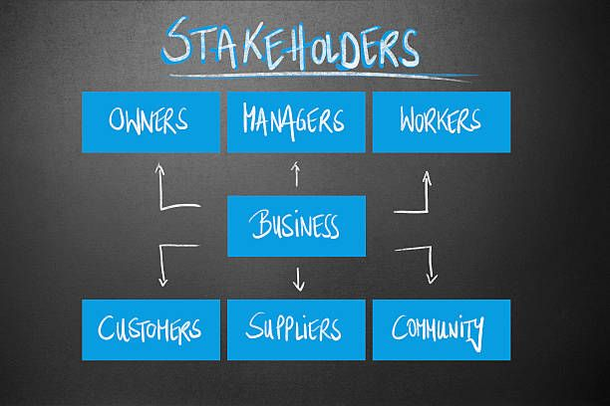

WHO ARE THE END USERS?
1) LEADERS
2) MANAGERS
3) EXECUTIVES
4)STAKEHOLDERS
5)EMPLOYEES

Slide 7

OUR SOLUTION AND ITS VALUE PROPOSITION
Make strides worker engagement : increment worker inclusion in objective setting and input forms, driving to higher work fulfillment and engagement
Enhance execution bits of knowledge : Pick up data-driven experiences into representative execution quality, patterns and zones for improvement
Faster development and improvement : Give focused on improvement openings, improving worker aptitudes and competencies.
Boost organizational efficiency : Adjust worker prisons with organizational targets, driving trade result and success.

Slide 8
Dataset Description
Employee data set taken form edunet dashboard
In dataset, out of 26 dataset I took only 9 features out of it.
The selected features are listed below:
Employee ID
First name
Last name
Business unit
Employee type
Employee status
Employee classification type
Gender code
Performance code
Current employee rating

Slide 9

THE "WOW" IN OUR SOLUTION
=IFS(Z8>=5,"VERY HIGH",Z8>=4,"HIGH",Z8>=3,"MED",TRUE,"LOW")
3/21/2024 Annual Review
9

Slide 10
MODELLING
1)DATA COLLECTION
The data has been collected through Edunet dash board.
2)FEEDBACK COLLECTION
The listed 10 features were taken for the analysis of data
3)DATA CLEANING
Identifying the missing values.
Filtering of those missing values.
4)CALCULATION OF PERFORMANCE LEVEL
By considering the current employee rating, I found the performance level using the formula.
5)SUMMARY PIVOT LEVEL
Segregating od certain to rows, columns, heading and so on.
6)VISUALIZATION
Once completed with pivot table, created the graph for precise visualization.
10

Slide 11
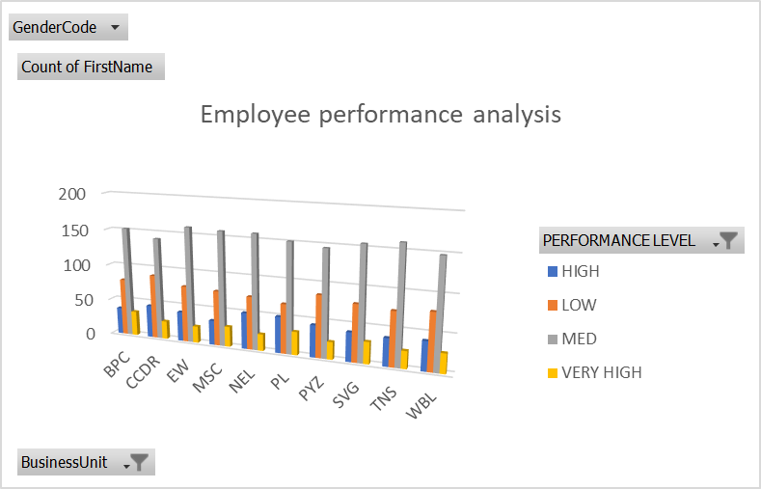
RESULTS
11

Slide 12
conclusion
The employee performance analysis project has effectively distinguished key regions for advancement in our organization execution administration forms. Through a comprehensive investigation of our current forms, we have revealed openings to upgrade representative development, advancement and efficiency. Execute objective setting and arrangement forms, create a normal criticism and coaching mechanisms.

